Slide 1
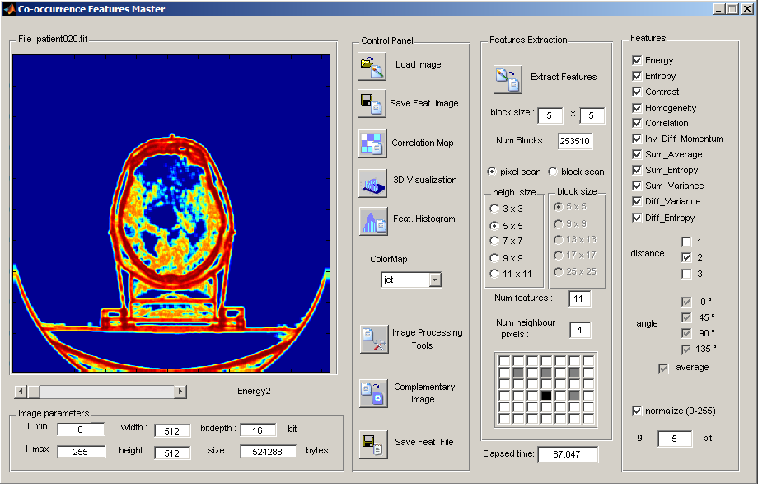
KeyRes Co-occurrence
Features Software*
* some described functionalities are available only in the full registered copy.

Slide 2
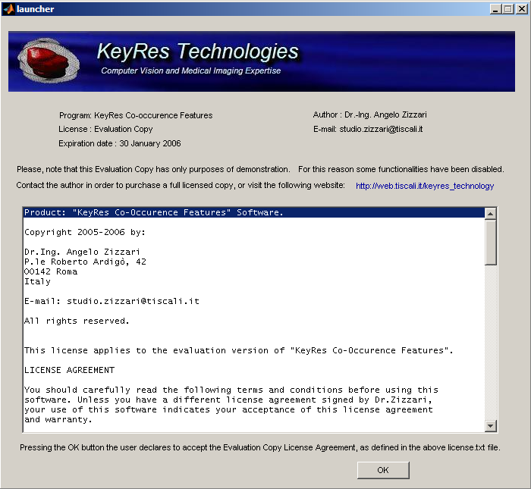
Click on ‘OK’ button

Slide 3
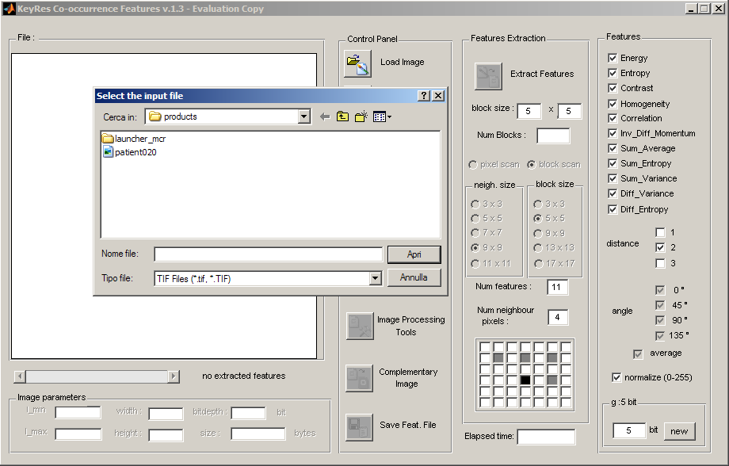
Load your Image File

Slide 4
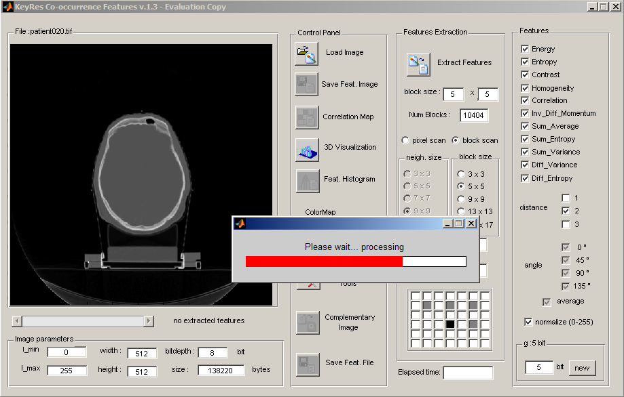
Click on ‘Extract Features’

Slide 5
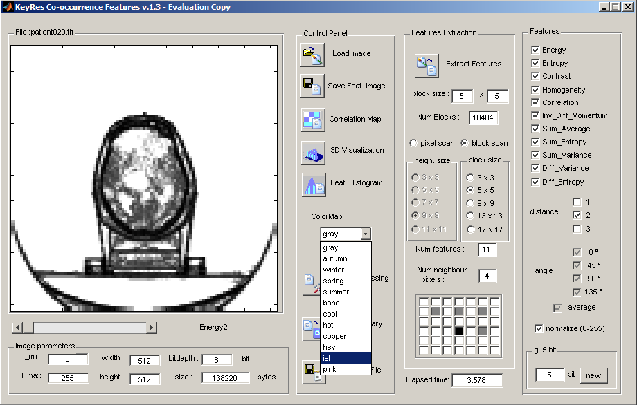
Choose a different color map

Slide 6
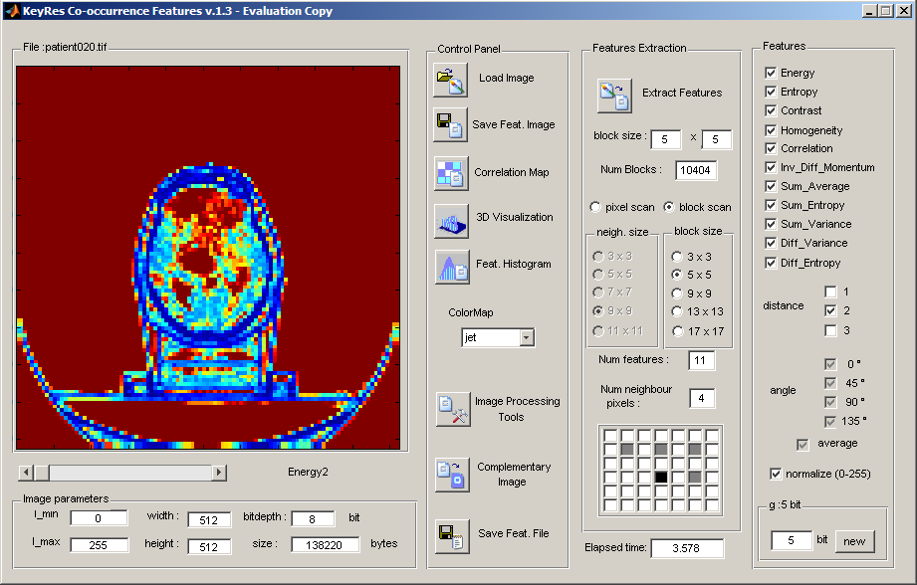
Click on ‘Complementary
Image’

Slide 7
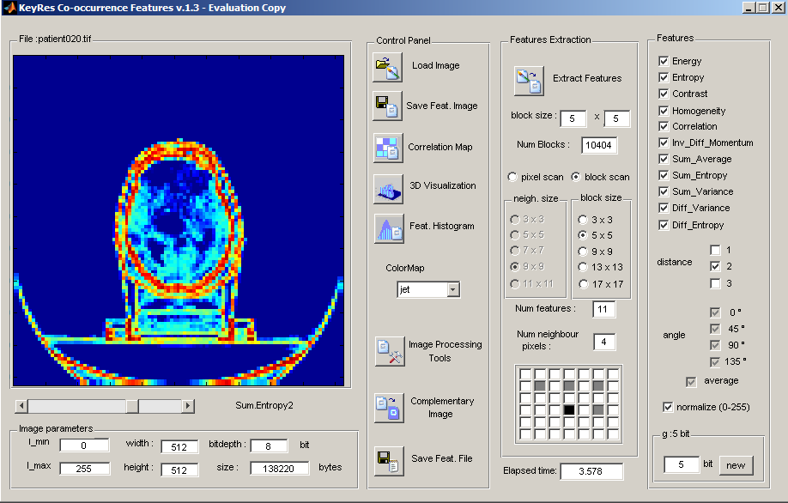
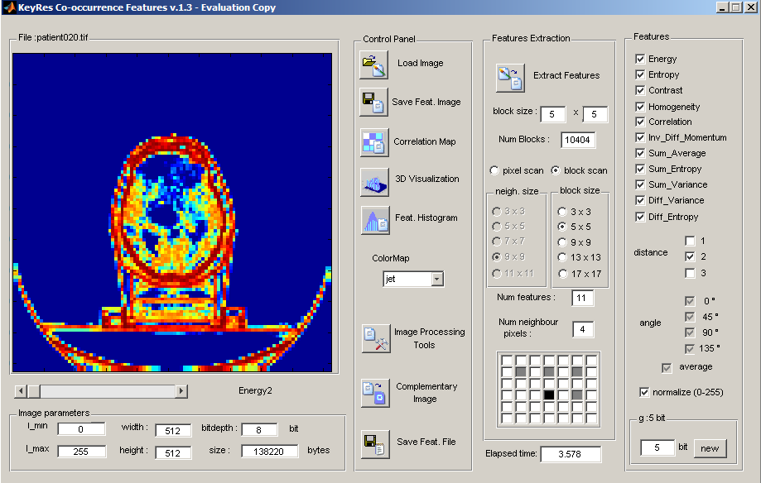
Use the lower slider to visualize different features

Slide 8
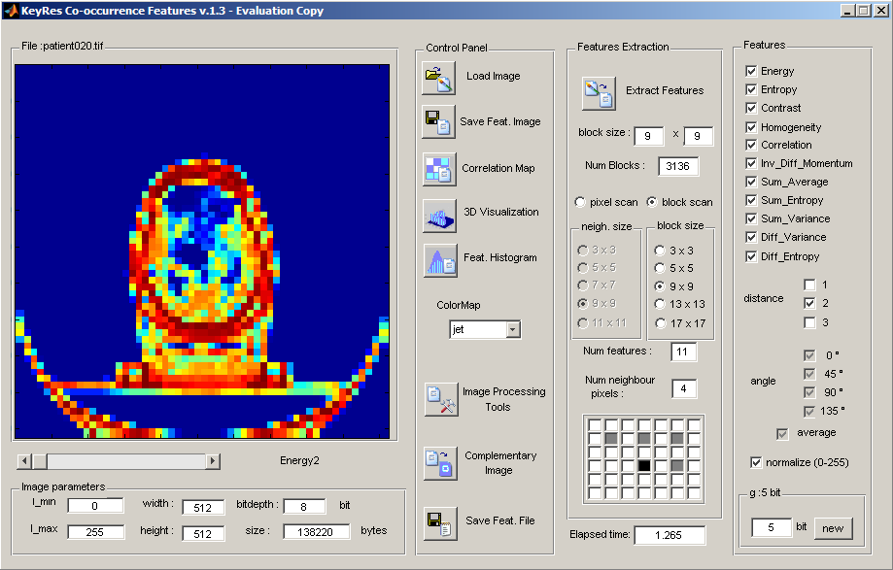
Choose a different block size (9x9) and click on ‘3D Visualization’

Slide 9
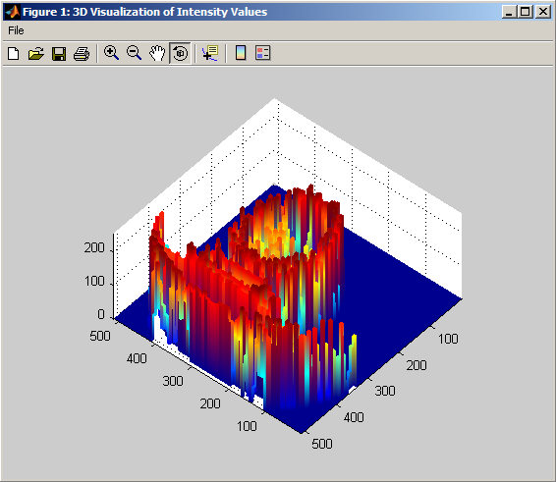
Choose a different block size (9x9) and click on ‘3D Visualization’

Slide 10
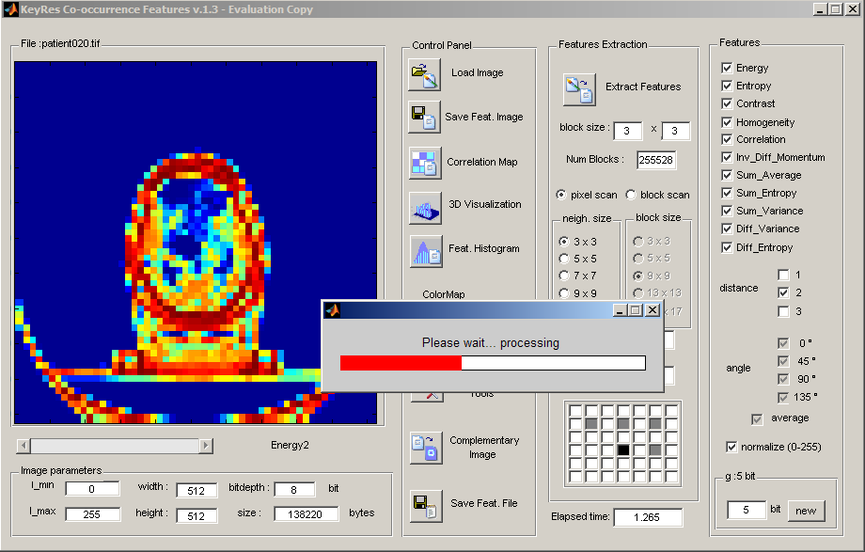
Choose a ‘pixel scan’ with neighbour size 3x3

Slide 11
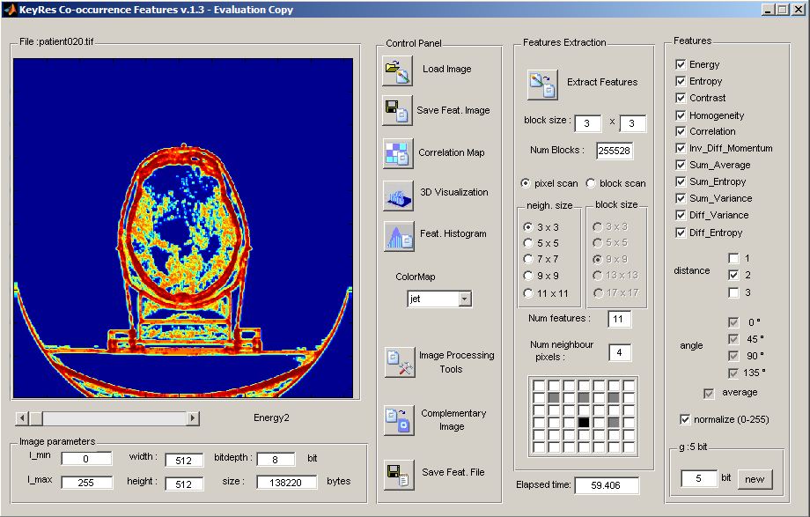
Click on ‘Correlation Map’

Slide 12
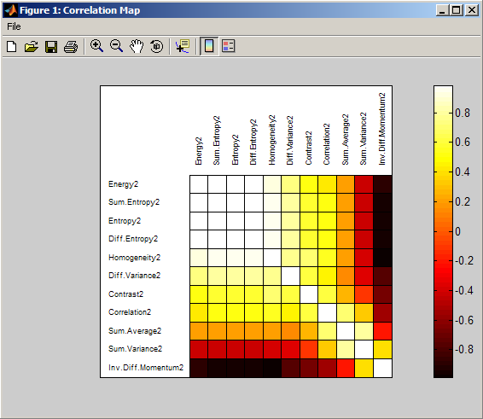
Select significant features…

Slide 13
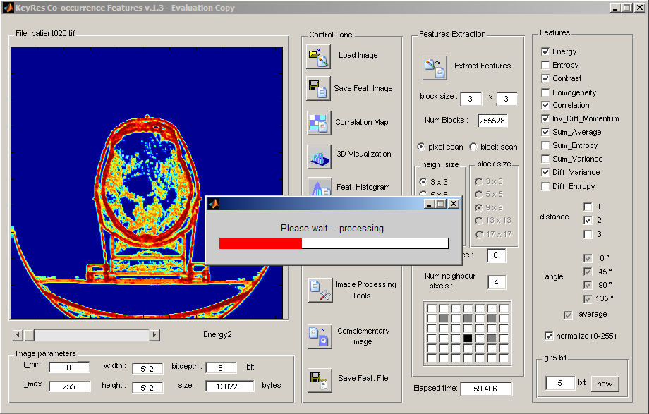
…and click again on
‘Extract Features’

Slide 14
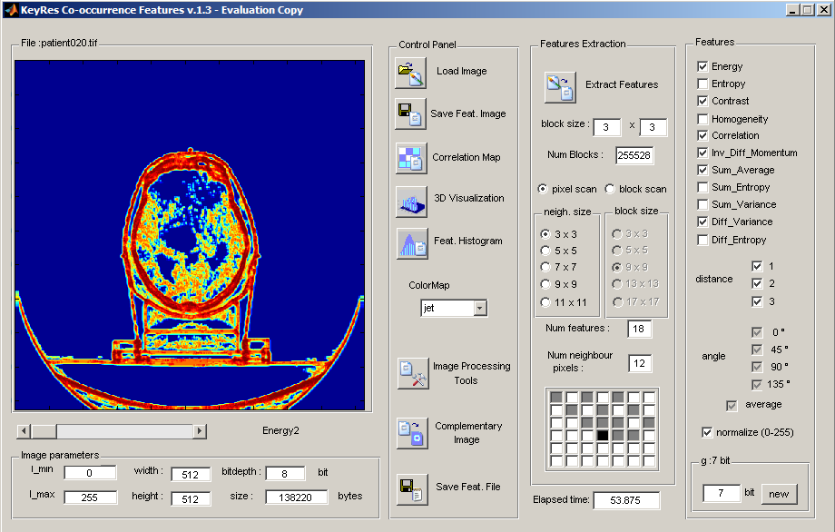
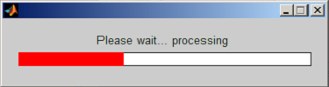
Select different pixel ‘distance’ and different ‘g’ : number of bits for gray levels in Co-occ Matrix

Slide 15
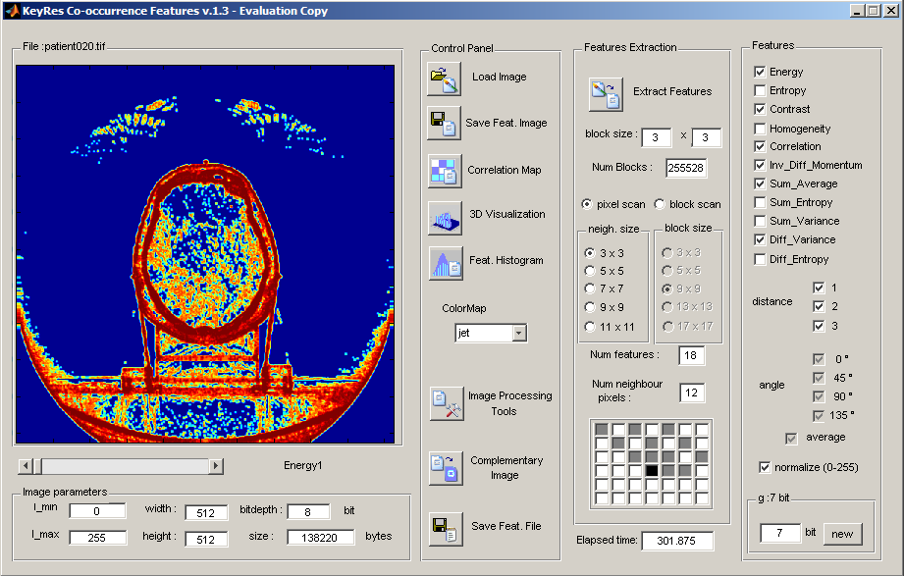
Some results with different ‘g’

Slide 16
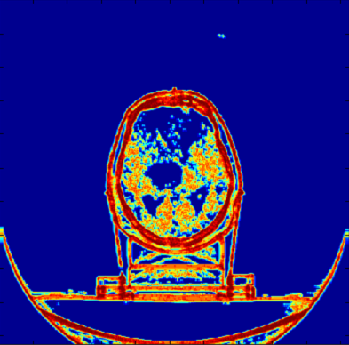
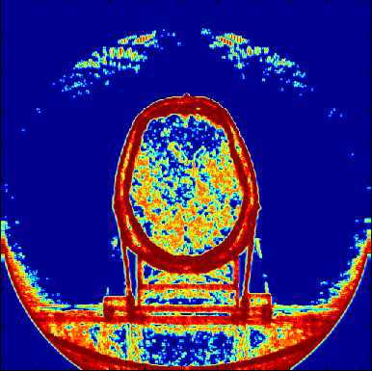
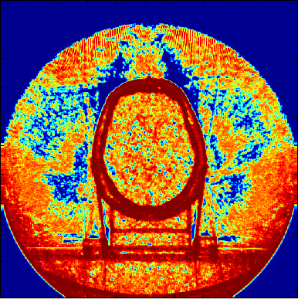
Some results with different ‘g’
g=5
g=7
g=12

Slide 17
Select different neighbour size (9x9)

Slide 18
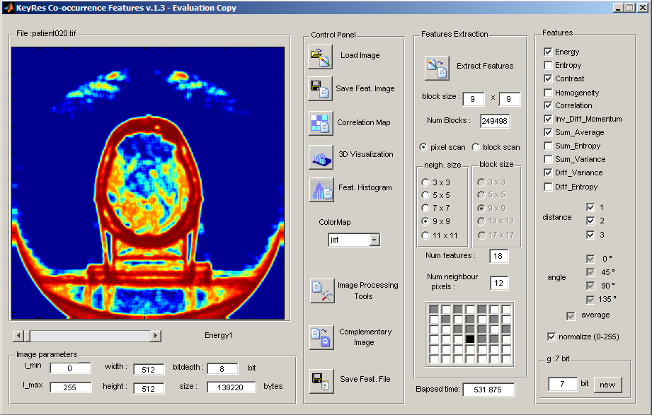
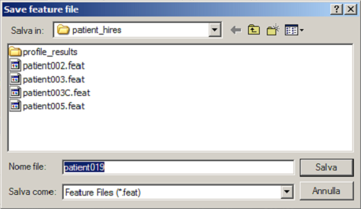
Save Features as a Text file…

Slide 19
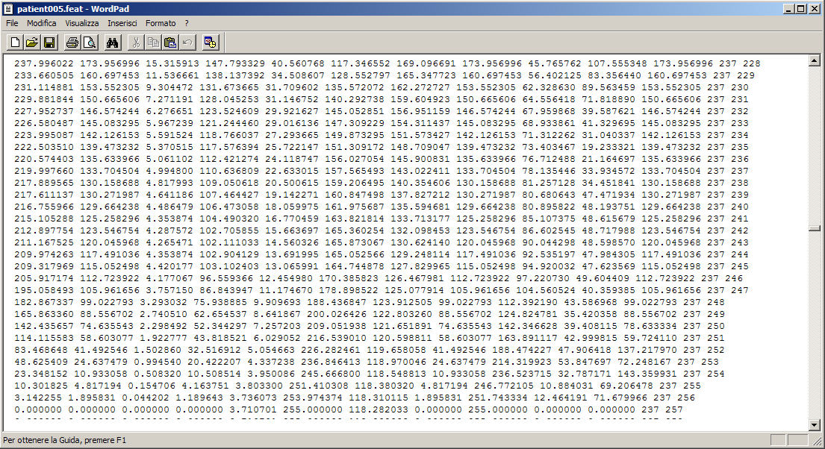
…and import in other programs for further operations

Slide 20
if you want to purchase a full registered copy, contact studio.zizzari@tiscali.it

